Slide 1
Advanced Deep Learning
Very Basic Understanding of GANs & Auto Encoders
Vraj Suratwala
Department of ICT, VNSGU

Slide 2
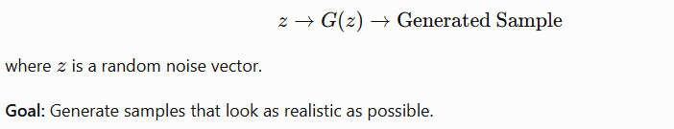
Generative Adversarial Networks
A Generative Adversarial Network (GAN) is a deep learning framework used to generate new data samples that resemble the training data. GANs consist of two neural networks—the Generator and Discriminator—which compete with each other during training.
Basic Architecture of GAN :
  A. Generator :
    The Generator creates new/artificial samples from a random input called latent noise.

Slide 3

Basic Architecture of GAN
B. Discriminator (D)
  The Discriminator receives both real and generated samples and determines whether a sample is real or fake.

Slide 4
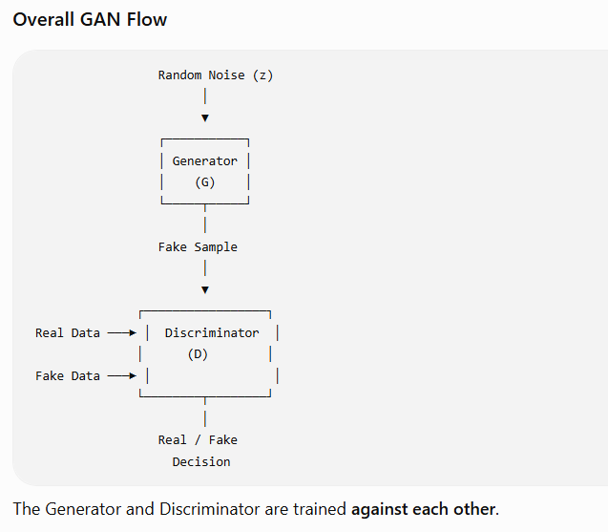

Slide 5
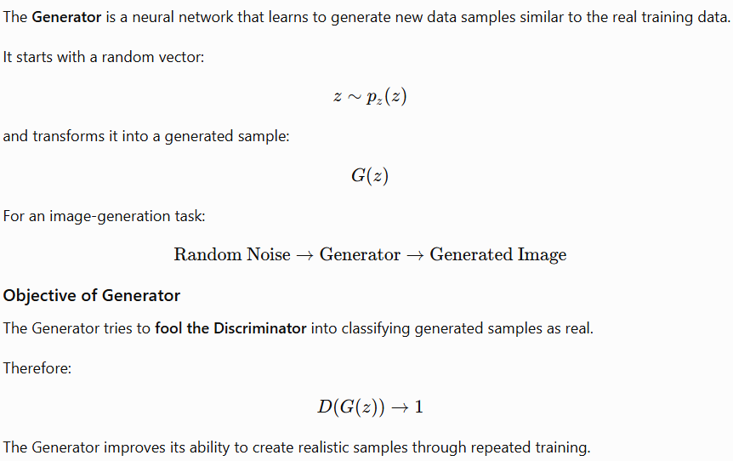
2. Generator

Slide 6
Example
If the GAN is trained using images of human faces:
Random Noise
↓
Generator
↓
Generated Face
↓
Discriminator
↓
"Real" or "Fake"
Over training, the Generator attempts to produce increasingly realistic faces.

Slide 7
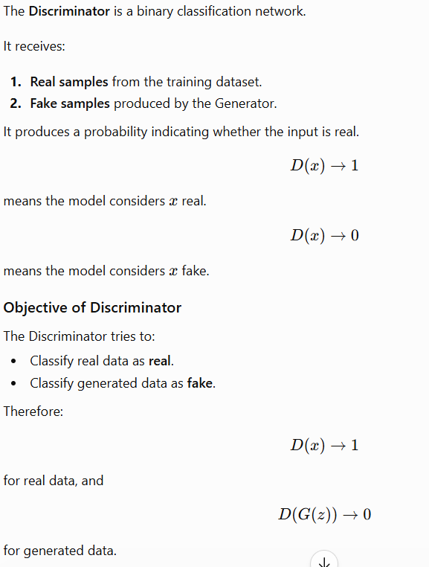
3. Discriminator

Slide 8
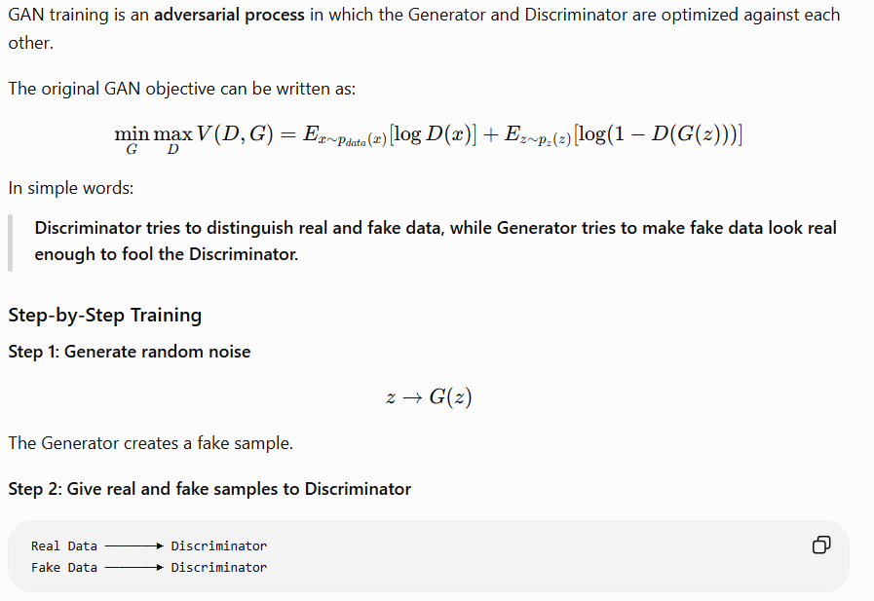
4. Training of GAN

Slide 9
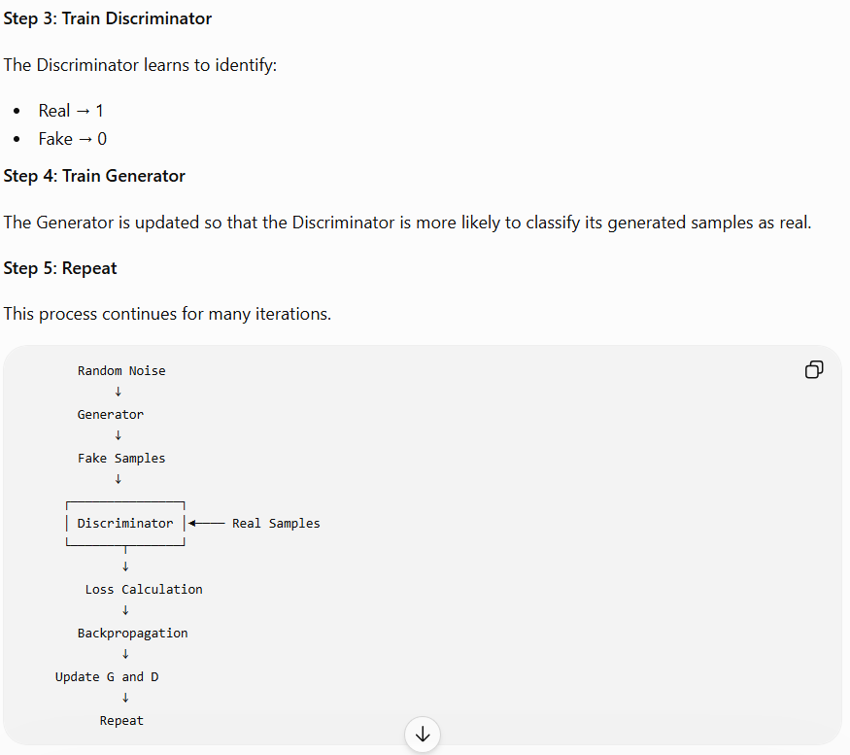
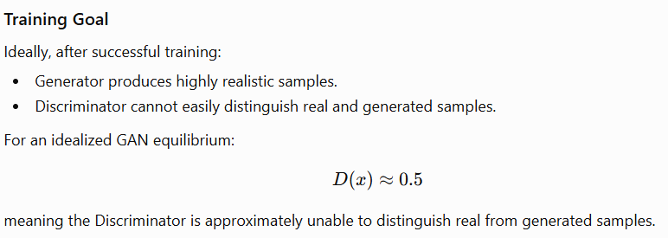

Slide 10
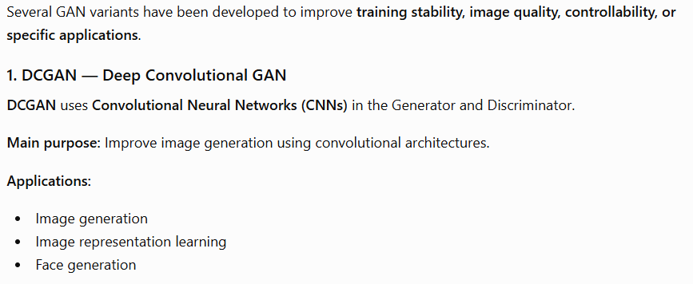
5. GAN Variants

Slide 11
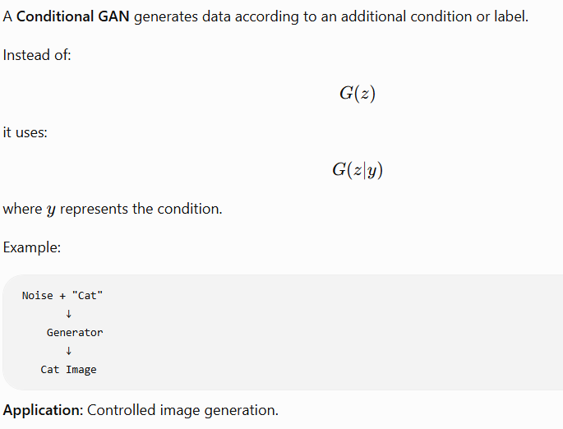
2. Conditional GAN (cGAN)

Slide 12
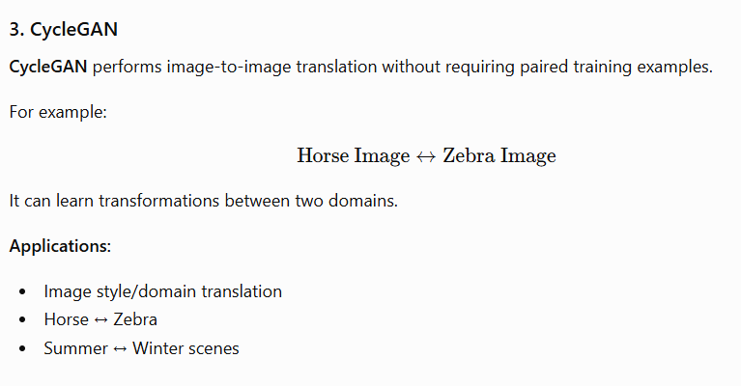
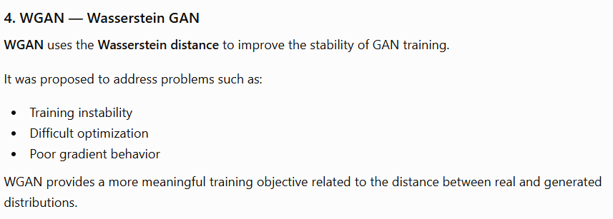

Slide 13
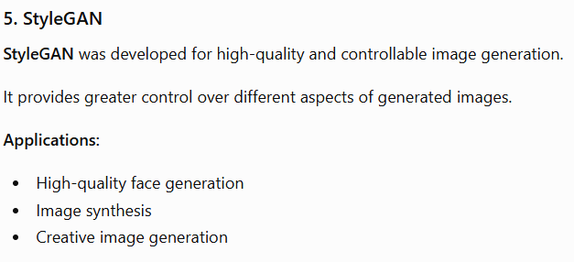

Slide 14
Pros & Cons
Advantages of GANs
Generates realistic synthetic data.
Can learn complex data distributions.
Useful when generating new examples is required.
Can be used for image-to-image translation.
Useful for data augmentation and creative applications.
Limitations
Training can be difficult and unstable.
Mode collapse may occur, where the Generator produces limited varieties of samples.
Generator and Discriminator must be balanced during training.
Evaluation of generated samples can be challenging.

Slide 15
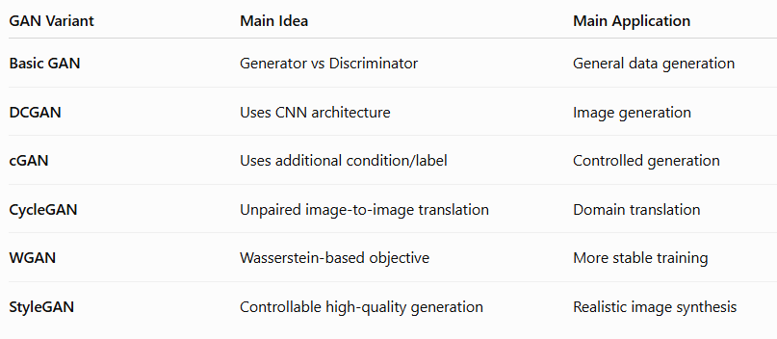
Summary

Slide 16
Auto Encoders
Under Complete Auto Encoder, Regularized Auto Encoder, Stochastic Encoder-Decoder, Contractive Encoders

Slide 17
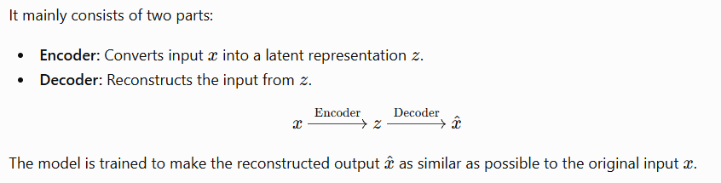
Autoencoder and Its Variants
An Autoencoder (AE) is a type of neural network that learns to represent input data in a lower-dimensional or meaningful form and then reconstruct the original input.

Slide 18
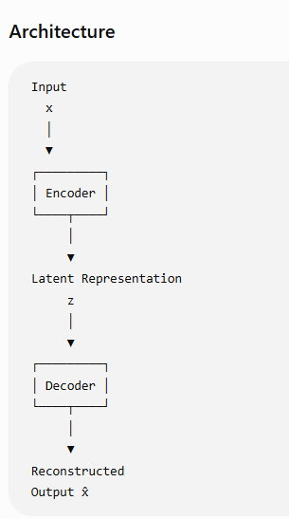
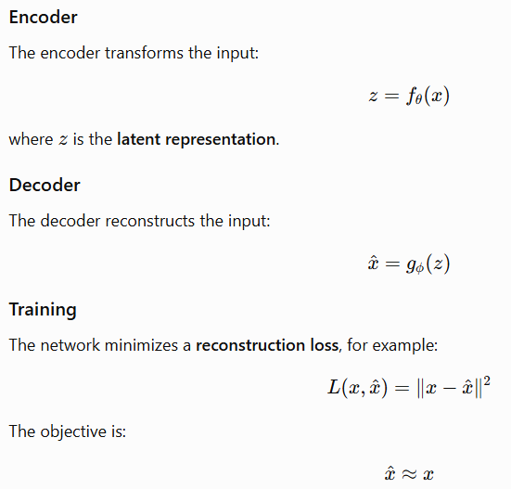
1. Basic Autoencoder

Slide 19
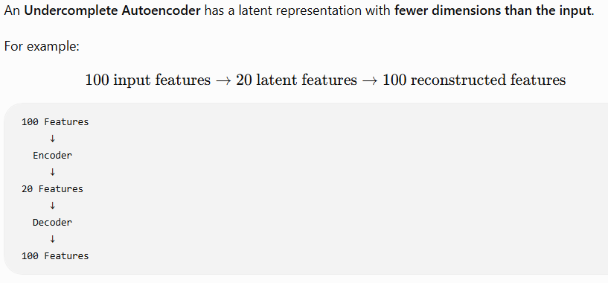
2. Undercomplete Autoencoder
Main Purpose
The bottleneck forces the network to learn the most important features of the input rather than simply copying the input.
Applications
Dimensionality reduction
Feature extraction
Data visualization
Noise reduction
Representation learning

Slide 20
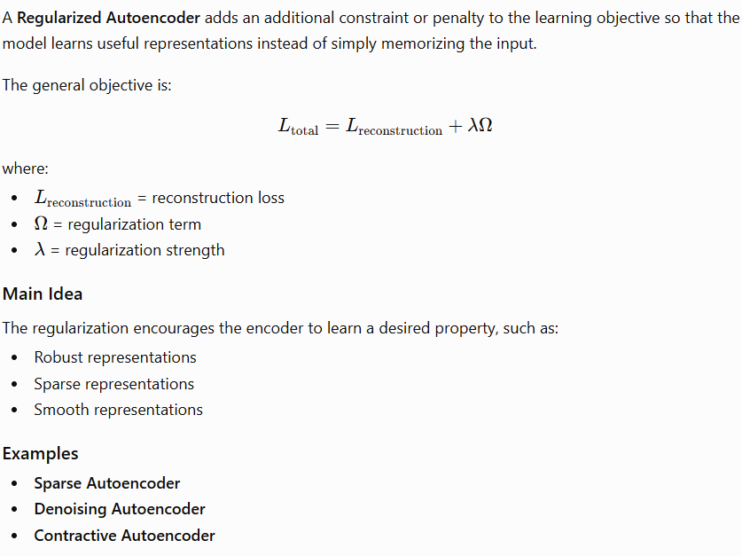
3. Regularized Autoencoder

Slide 21
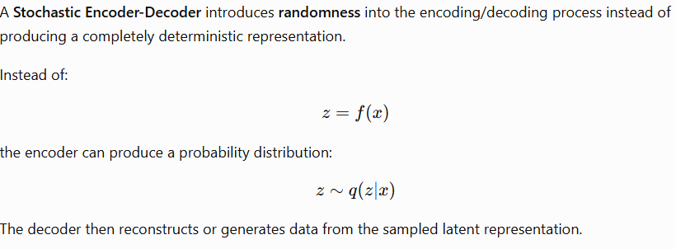
4. Stochastic Encoder-Decoder
Basic Flow
Input x
↓
Encoder
↓
Probability Distribution
↓
Sample z
↓
Decoder
↓
Reconstructed Output
A well-known example is the Variational Autoencoder (VAE).
Advantages
Learns a structured latent space.
Can generate new samples.
Useful for generative modeling.
Introduces controlled randomness into the representation.

Slide 22
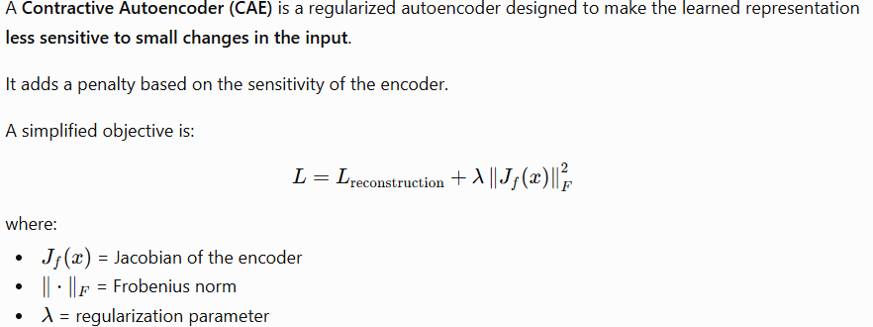
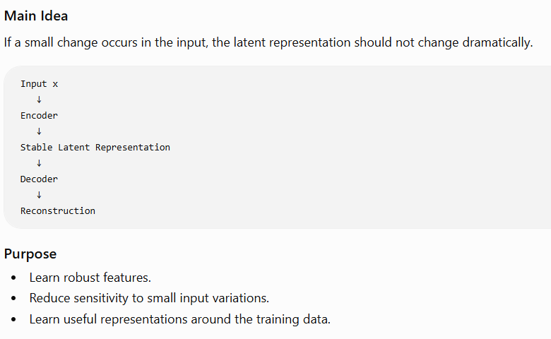
5. Contractive Autoencoder

Slide 23
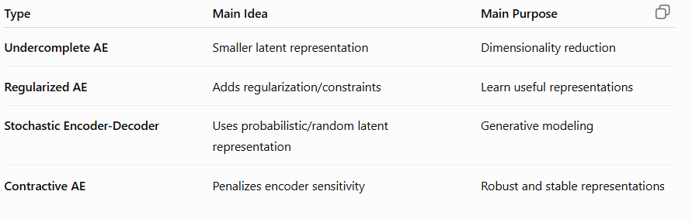
Summary

Slide 24
Thank You
Vraj Suratwala
Department of ICT, VNSGU

